Slide 1
Navigating Campus Technology
Presented by Stephanie Jasmin

Slide 2
Department of Information Technology
Our Vision
The mission of the DoIT is to empower the user community to effectively use information technologies in achieving a higher level of academic success; facilitating academic innovation in teaching, learning, research and scholarship; and delivering excellent administrative services in support of the College’s mission.
For a copy of this powerpoint visit:
http://jjcweb.jjay.cuny.edu/orientationfall13

Slide 3
Available Resources for Students
CLSS – Classroom and Lab Support Services
Email
CUNY PORTAL – eSims, Blackboard, Financial Aid
JSTOP- Online Student Information Center
Help Desk
Blackboard Support Services
For a copy of this powerpoint visit:
http://jjcweb.jjay.cuny.edu/orientationfall13

Slide 4
Classroom and Lab Support Services
For a copy of this powerpoint visit:
http://jjcweb.jjay.cuny.edu/orientationfall13

Slide 5
Classroom & Lab Support Services (CLSS)
Mission Statement
To lead in the development and deployment of new educational technology and to provide the training required to effectively integrate technology into the instructional program.
For a copy of this powerpoint visit:
http://jjcweb.jjay.cuny.edu/orientationfall13

Slide 6
Computer Labs
Our Staff
CLSS
Around The Campus
EZ Printing
Classroom & Lab Support Services (CLSS)
Classroom Technology
Laptop Loaner and iPad Loaner Programs
For a copy of this powerpoint visit:
http://jjcweb.jjay.cuny.edu/orientationfall13

Slide 7
Helpdesk and Client Services

Slide 8
Helpdesk & Client Support Center
Student, faculty, and staff email
Access and support for the CUNY Portal and Blackboard
Computer hardware and software technical support for college issued computers and laptops
Telephone, voicemail and the college telephone directory
Network and wireless connectivity issues
John Jay hosted and supported applications and servers
Classroom equipment problems
Internet and Inside John Jay (Intranet) Support
Instructional Support Technology Services Information
Mainframe and web services
For a copy of this powerpoint visit:
http://jjcweb.jjay.cuny.edu/orientationfall13

Slide 9
WIFI- Network Access

Slide 10
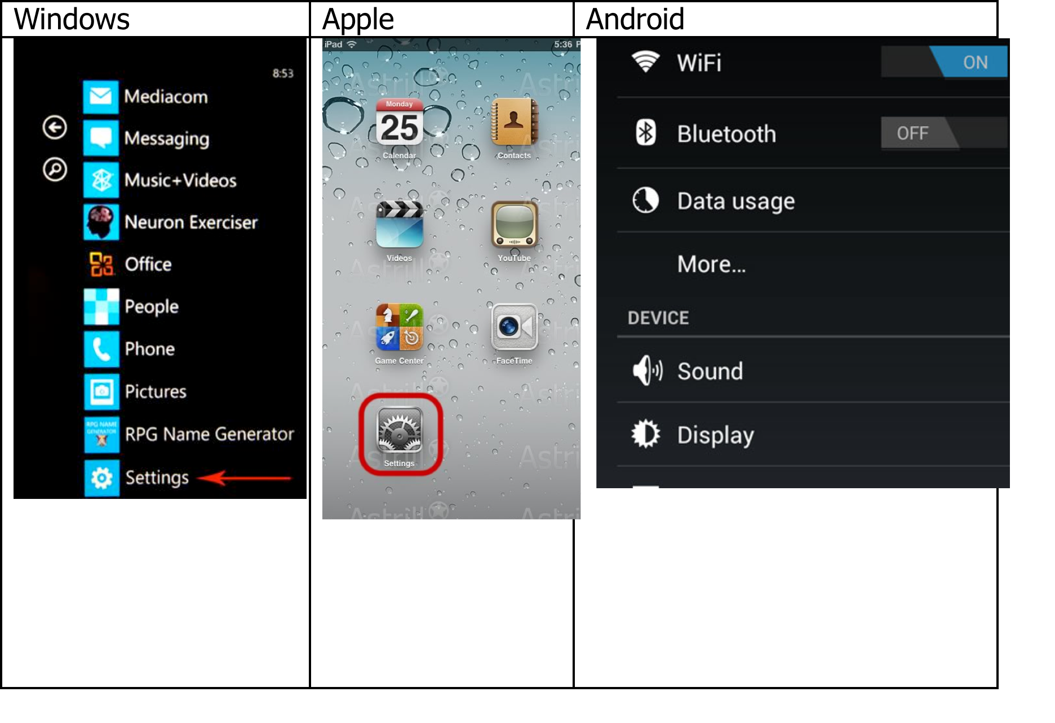
WIFI
ENTER YOUR PHONE’S OR TABLET’S WIRELESS SETTINGS SCREEN
For a copy of this powerpoint visit:
http://jjcweb.jjay.cuny.edu/orientationfall13

Slide 11
WIFI
Choose “John Jay Students” Wireless network
Enter your John Jay Credentials (Firstname.Lastname & Password)
For a copy of this powerpoint visit:
http://jjcweb.jjay.cuny.edu/orientationfall13

Slide 12
Adding Your John Jay Email to your Device
Documents for this can be found on our orientation website OR
Drop by our helpdesk
For a copy of this powerpoint visit:
http://jjcweb.jjay.cuny.edu/orientationfall13

Slide 13
Blackboard Student Support
Blackboard is an online learning management system
Provides remote access to course materials [syllabi, lecture notes, scanned articles, and images as well as create links to library resources], assignments, and class discussions
For a copy of this powerpoint visit:
http://jjcweb.jjay.cuny.edu/orientationfall13

Slide 14
Blackboard Student Support
Email, phone, and walk-in support
In class demonstrations
Workshops
For a copy of this powerpoint visit:
http://jjcweb.jjay.cuny.edu/orientationfall13

Slide 15
Department of Information Technology
Thank you
For a copy of this powerpoint visit:
http://jjcweb.jjay.cuny.edu/orientationfall13

